Slide 1
Mitigating the Risks of Generative AI: Deepfake Detection and Prevention
BBVA
PRESENTERS:
Michael Madden - Information Security
Vishesh Shah - Information Security
Erik Dali - Global Markets, Data Scientist & Algorithmic Trading
DATE:
February 7th, 2025

Slide 2
AGENDA
Intro
Generation Techniques
Detection Paradigm

Slide 3
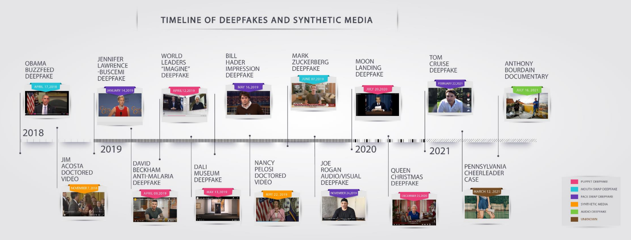
Problem Statement
With the latest advancements in generative AI and the widespread accessibility of models and hardware, deepfakes are becoming more prevalent, hyper-realistic, and harder to distinguish from authentic media. The ability to manipulate audio, images, and videos with high fidelity and minimal expertise has significantly lowered the barrier for malicious use. This poses serious threats, including fraud, identity theft, misinformation, and the erosion of public trust in digital content, highlighting the urgent need for robust detection mechanisms and ethical safeguards.
Source: DHS Increasing Threats of Deepfake Identities

Slide 4
Problem Statement
This surge in deepfake technology presents serious risks across multiple domains.
In cybersecurity, fraud and identity theft have become more sophisticated, with criminals leveraging AI-generated voices and videos to impersonate individuals, gain unauthorized access to sensitive information, or deceive organizations.
Finance worker pays out $25 million after video call with deepfake ‘chief financial officer’
In politics and media, the spread of misinformation and disinformation has intensified, undermining public trust in news and institutions.
Additionally, the rise of AI-generated explicit content, reputational attacks, and deepfake scams further highlights the ethical and legal challenges posed by these rapidly evolving technologies.

Slide 5
Problem Statement
As deepfakes become more convincing and their misuse more widespread, the urgency for robust detection methods, AI governance, and digital content authentication has never been greater.
Addressing these risks requires a combination of technological improvements, regulatory frameworks, and public awareness initiatives to mitigate the potential dangers posed by the unchecked proliferation of deepfake content.
There have been several notable industry initiatives

Slide 6
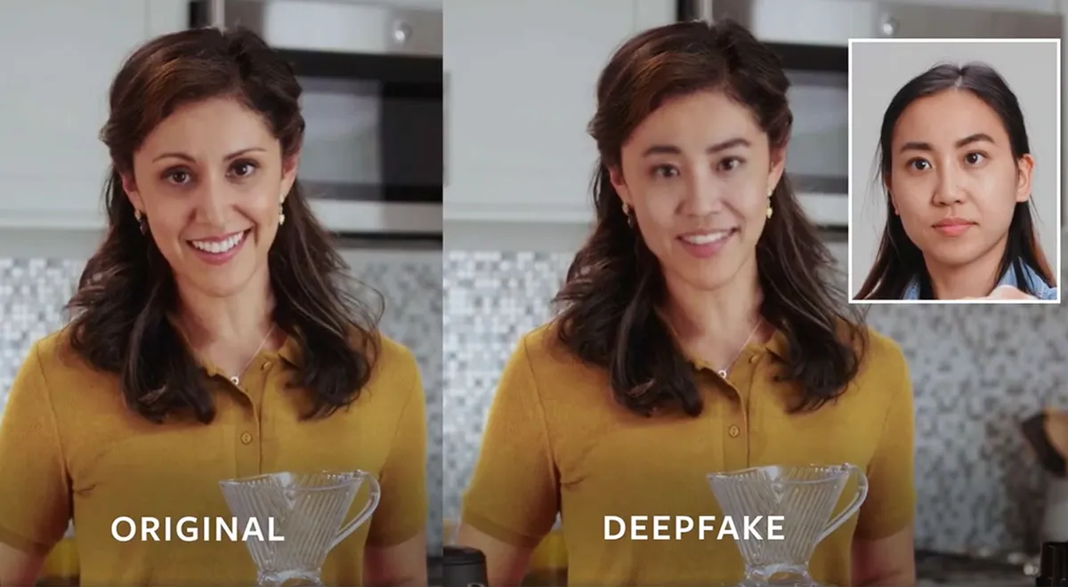
Industry Initiatives: Deepfake Detection Challenge (DFDC) 2020
AWS, Facebook/Meta, Microsoft, the Partnership on AI’s Media Integrity Steering Committee, and academics together created the Deepfake Detection Challenge (DFDC). The goal of the challenge was to spur researchers around the world to build innovative new technologies that can help detect deepfakes and manipulated media.
Challenge Objective: Identify videos with facial or voice manipulations
Rewards: $1 million with $500k going to the top model
Results: Out of sample detection accuracy was 60%
Source: Facebook/Meta

Slide 7
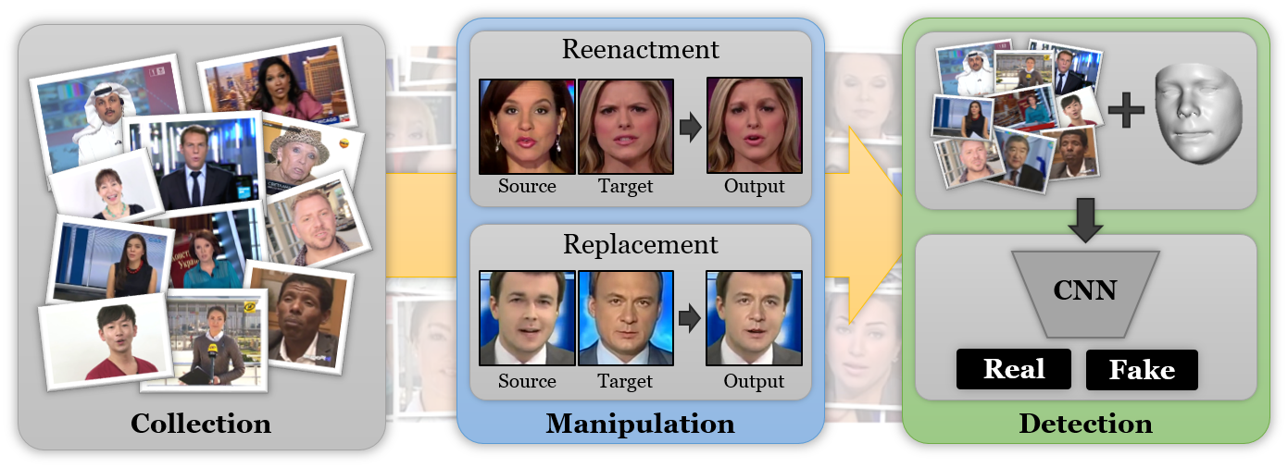
Industry Initiatives: FaceForensics++ Dataset
Google contributed to a large dataset of visual deepfakes they produced which has been incorporated into the Technical University of Munich and the University Federico II of Naples’ FaceForensics benchmark, an effort co-sponsored by Google.
The benchmark and dataset are meant to spur research in deepfake detection
FaceForensics++ is a forensics dataset consisting of 1000 original video sequences that have been manipulated with four automated face manipulation methods: Deepfakes, Face2Face, FaceSwap and NeuralTextures. The data has been sourced from 977 youtube videos.
Source: FaceForensics++

Slide 8
Solution Overview
Solution Approach: A privacy-focused deepfake detection for identity verification
Your Solution: A deep learning model that verifies authenticity using a reference video
Our model validates authenticity using a reference video taking into account both individual features and deepfake artifacts
Key Features:
Easy to implement and integrate into existing applications
Can be implemented within organizations using individual provided data. And a public implementation for news and media which can scrap available data for public figures
Requires minimal device overhead
Continuously improve the model architecture as the number of users increases
Industry impact
Our solution will reduce the incidence of GenAI powered fraud by combating the offensive use of AI with defensive use of AI

Slide 9
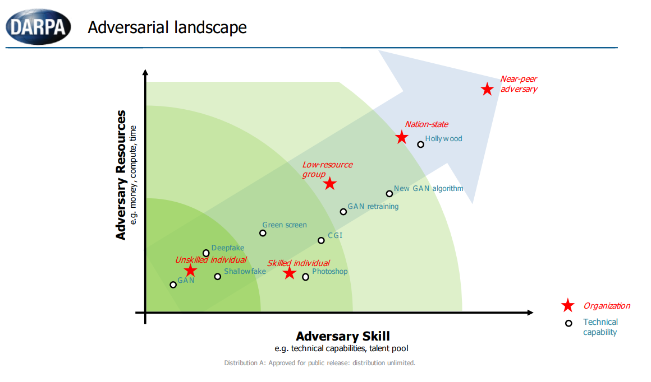
Solution Scope and Effectiveness
Scope: our solution increases the barriers for malicious use of GenAI and deepfakes
Effectiveness: The effectiveness of this solution mainly relies on its scale. In its infancy stage it should be effective against unskilled and skilled individuals. With relatively low cost it should raise the barrier to a level where only nation-states pose challenges

Slide 10
Technical Implementation: Tech Stack Overview
Frameworks & Libraries:
PyTorch – Core deep learning framework for training and inference
Torchvision – The package consists of popular datasets, model architectures, and common image transformations for computer vision
Facenet-PyTorch – Face detection (MTCNN) and feature extraction (InceptionResNetV1)
MTCNN - Multitask Cascaded Convolutional Networks for Face Detection and Alignment
InceptionResNetV1 - A resnet50 implementation pretrained on VGGFace2 and CASIA-Webface
OpenCV – Video processing and frame extraction
Hardware & Compute Resources
NVIDIA GPU (CUDA) – Accelerated model training & inference
AWS SageMaker – Cloud-based training and deployment

Slide 11
Technical Implementation: Architecture Diagram
General Architecture
Detection Model
Feature Encoder
Temporal Siamese Model
General Architecture: Within this framework we can substitute various models to perform each stage and find the best model
Detection stage: we want to restrict the input to the next stage to where there may be tempering. In videos this could be someone’s face. In audio it could be isolating the correct voice.
Feature Encoder stage: this stage’s takes is to extract the relevant features of the input
Siamese Stage: Compares the unvalidated input against the reference input. For example patterns of facial expression

Slide 12
Technical Implementation: Architecture Diagram
Example Architecture
Detection Model: MTCNN
Feature Encoder:
resnet50 ex last layer
Temporal Siamese Model:
2-layer Siamese NN
Test Architecture: We picked a few well-known models to perform each stage
Detection stage: MTCNN - Multitask Cascaded Convolutional Networks for Face Detection and Alignment
Feature Encoder stage: ResNet50 which is a 50 layer convolutional network pre-trained for facial recognition. We drop the last layer of the network which performs classification based on the features
Temporal Siamese Stage: A basic 2-layer NN that takes the extracted feature from the reference video and the unvalidated video to determine authenticity

Slide 13
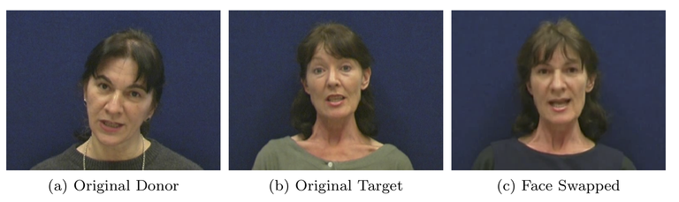
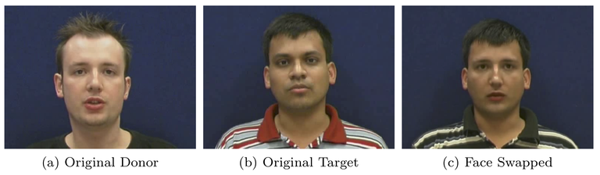
Technical Implementation: Data Usage
DeepfakeTIMIT: this is our deepfake dataset. The authors created these deepfakes using the VidTIMIT dataset by taking 16 similar looking individuals where faces are swapped using the open source GAN-based approach, which, in turn, was developed from the original autoencoder-based Deepfake algorithm.
VidTIMIT: This is our reference dataset. A dataset comprised of video and corresponding audio recordings of 43 people, reciting short sentences.
Processing: For each person we take an original video from VidTIMIT dataset as their reference video. And compare it to a deepfake of them from DeepfakeTIMIT.
Source: DeepfakeTIMIT

Slide 14
Technical Implementation: Model Performance and Results
In Jupyter Notebook

Slide 15
Industry Impact, and Production Viability
Potential Path to Production
The Deepfake detection solution can be deployed in production by integrating it into identity verification systems(i.e Know Your Customer systems), financial fraud detection platforms, and media authentication pipelines.
Scalability of our solution at an enterprise level
It is crucial to ensure that deepfake detection system can handle large volumes of data, real time processing needs, and continuous model improvement. The proposed solution is designed to be highly scalable through modular design and use of pre-trained models
Potential challenges and limitations
As deepfake methodologies evolve, the detection must improve to maintain effectiveness
Deepfake detection and countermeasures are only another layer of security
Computational Costs - Running real-time deepfake detection on high resolution videos is resource intensive.
Regulatory & Privacy Concerns - Enterprise adoption requires strict adherence to data privacy laws(GDPR, CCPA)

Slide 16
Demo
Execute the repo

Slide 17
Appendix

Slide 18
References
U.S. Department of Homeland Security. (n.d.). Increasing Threat of DeepFake Identities. Retrieved from https://www.dhs.gov/sites/default/files/publications/increasing_threats_of_deepfake_identities_0.pdf
Kaggle. (n.d.). Deepfake Detection Challenge. Retrieved from https://www.kaggle.com/competitions/deepfake-detection-challenge
benpflaum, B. G., djdj, I., Kofman, J. E., Tester, J. L., Elliott, J., Metherd, J., Mozaic, P. C., Dane, S., & Kim, W. (2019). Deepfake Detection Challenge. Kaggle. Retrieved from https://kaggle.com/competitions/deepfake-detection-challenge
Rössler, A., Cozzolino, D., Verdoliva, L., Riess, C., Thies, J., & Nießner, M. (2019). FaceForensics++: Learning to Detect Manipulated Facial Images. International Conference on Computer Vision (ICCV).
Zhang, K., Zhang, Z., Li, Z., & Qiao, Y. (2016). Joint Face Detection and Alignment Using Multitask Cascaded Convolutional Networks. IEEE Signal Processing Letters, 23(10), 1499-1503. https://doi.org/10.1109/LSP.2016.2603342
He, K., Zhang, X., Ren, S., & Sun, J. (2015). Deep Residual Learning for Image Recognition. arXiv preprint, arXiv:1512.03385. Retrieved from https://arxiv.org/abs/1512.03385
Korshunov, P., & Marcel, S. (n.d.). DeepFakes: A New Threat to Face Recognition? Assessment and Detection. arXiv and Idiap Research Report.
Sanderson, C., & Lovell, B. C. (2009). Multi-Region Probabilistic Histograms for Robust and Scalable Identity Inference. Lecture Notes in Computer Science (LNCS), 5558, 199-208.

